Slide 1
EE2211 Tutorial 8
(remember to sign your attendance on the sheet of paper)

Slide 2
Lecture recap

Slide 3
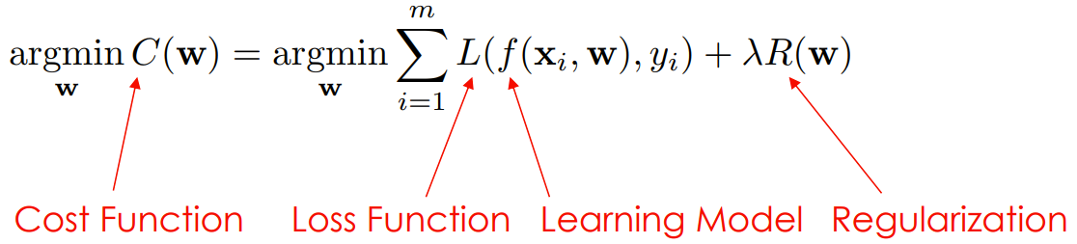
Loss function & Learning model

Slide 4
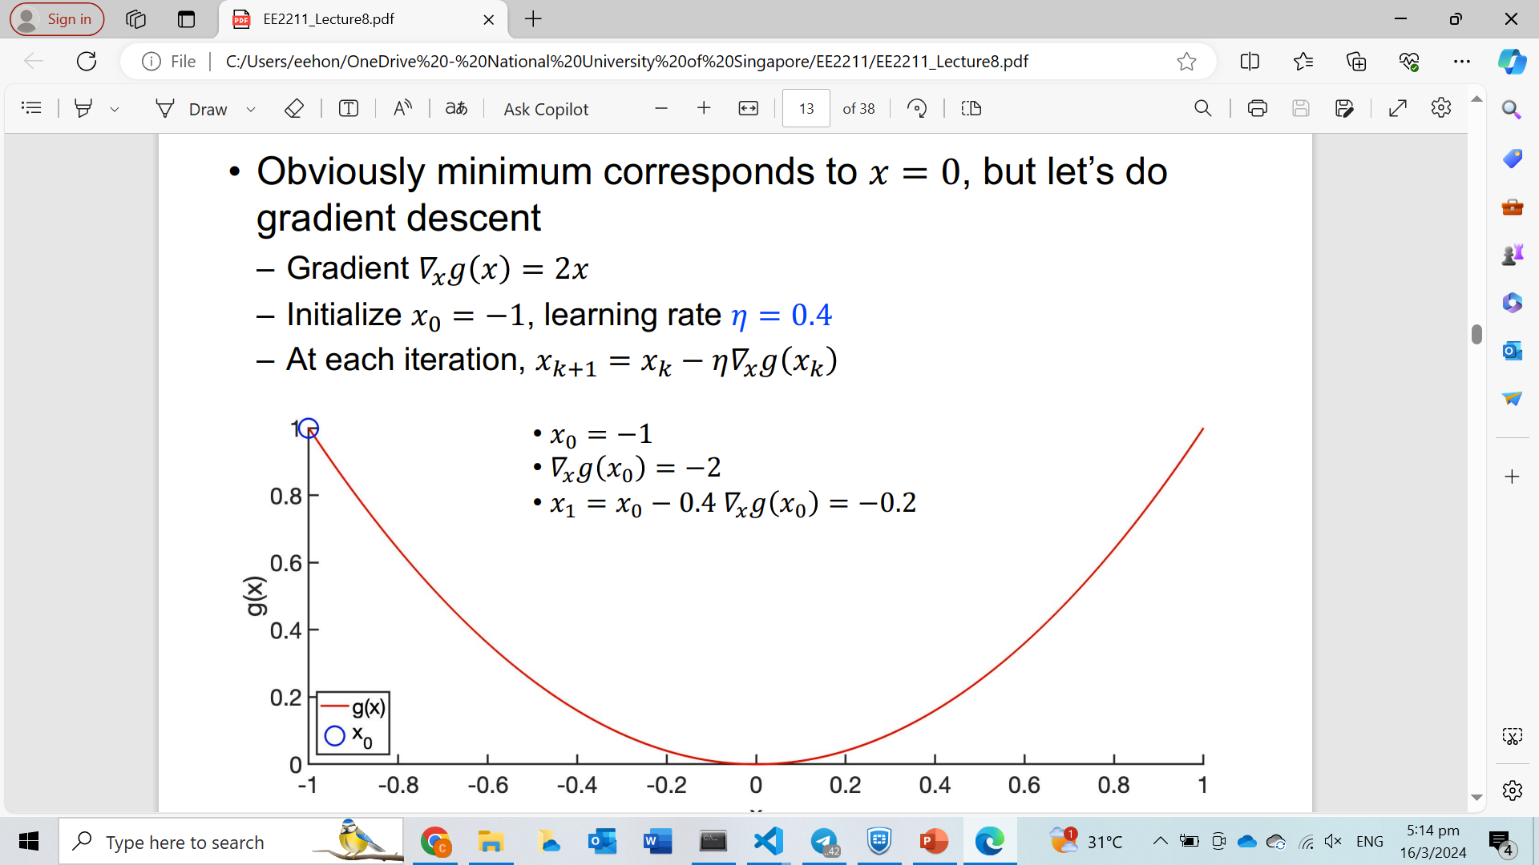
Gradient descend

Slide 5
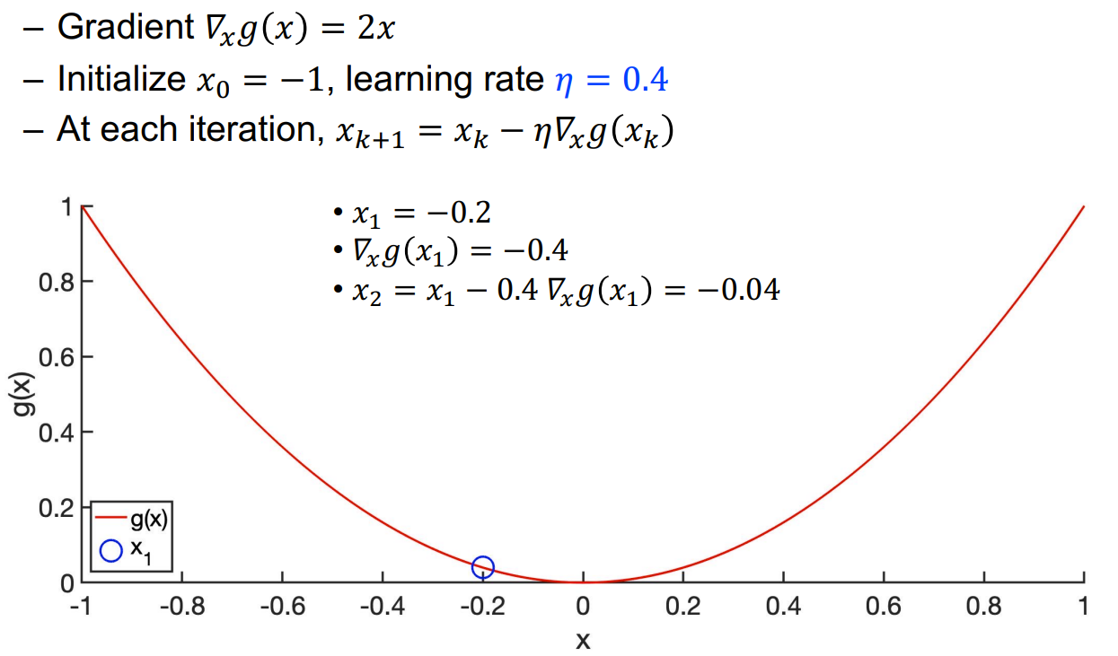
Gradient descend

Slide 6
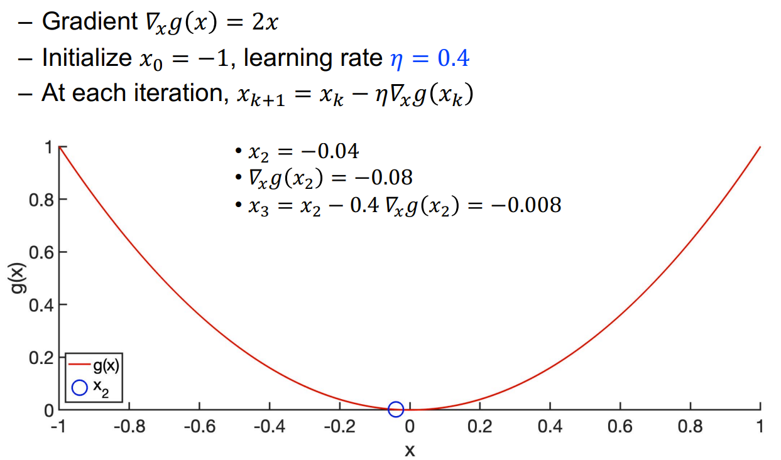
Gradient descend

Slide 7
Learning rate
If learning rate is too big, may jump between local minimas and never converge
If learning rate is too small, may take too long to converge

Slide 8
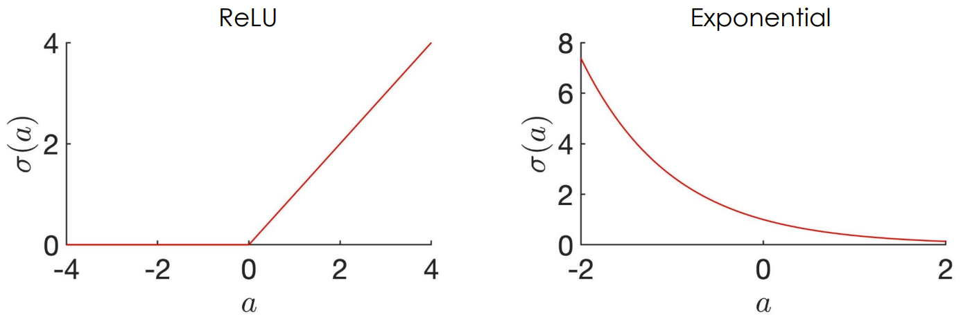
Different learning models

Slide 9
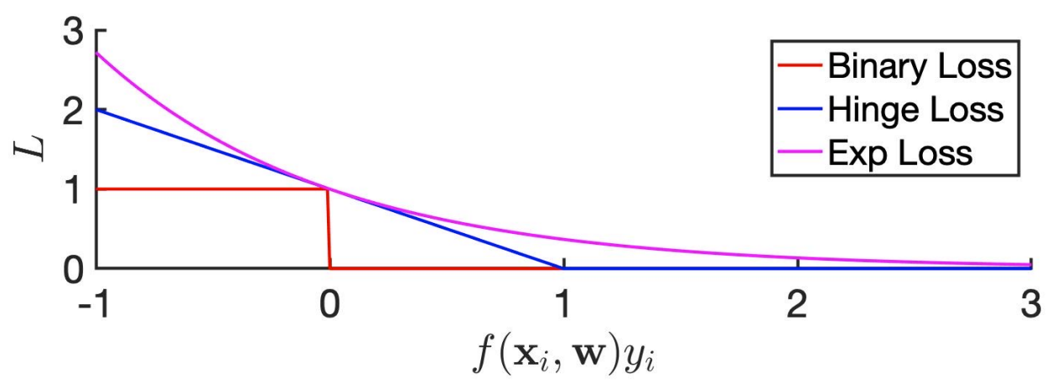
Different loss functions

Slide 10
Tutorial 8

Slide 11
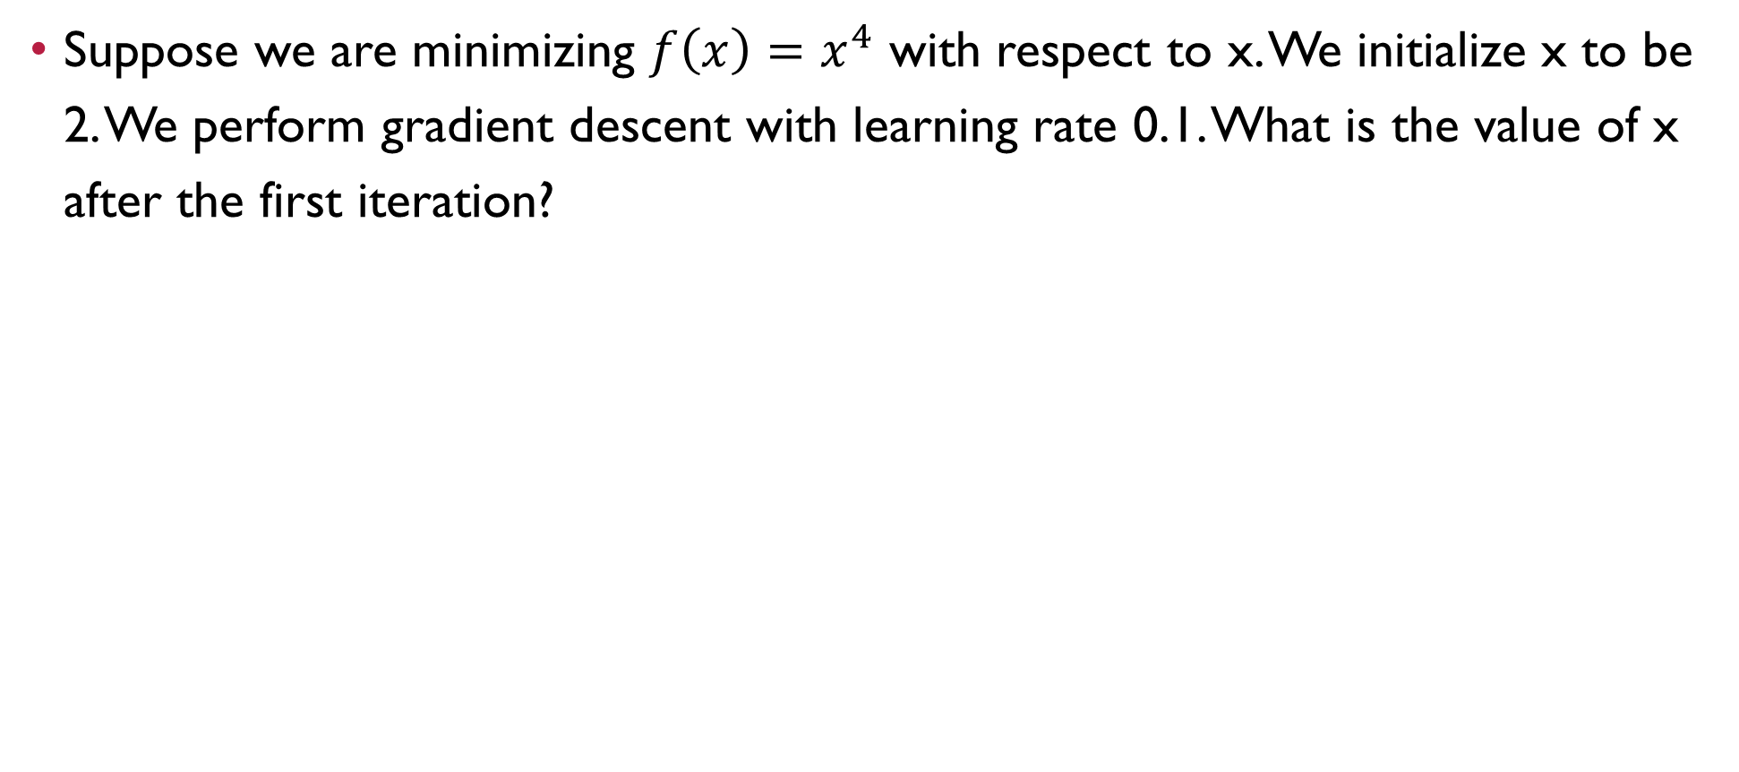
Question 1
Suppose we are minimizing $f\left(x\right)=x^{4}$ with respect to x. We initialize x to be 2. We perform gradient descent with learning rate 0.1. What is the value of x after the first iteration?

Slide 12
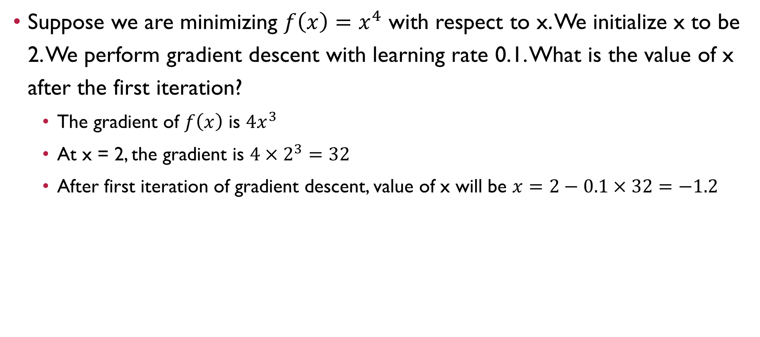
Question 1
Suppose we are minimizing $f\left(x\right)=x^{4}$ with respect to x. We initialize x to be 2. We perform gradient descent with learning rate 0.1. What is the value of x after the first iteration?
The gradient of $f\left(x\right)$ is $4x^{3}$
At x = 2, the gradient is $4×2^{3}=32$
After first iteration of gradient descent, value of x will be $x=2−0.1×32=−1.2$

Slide 13
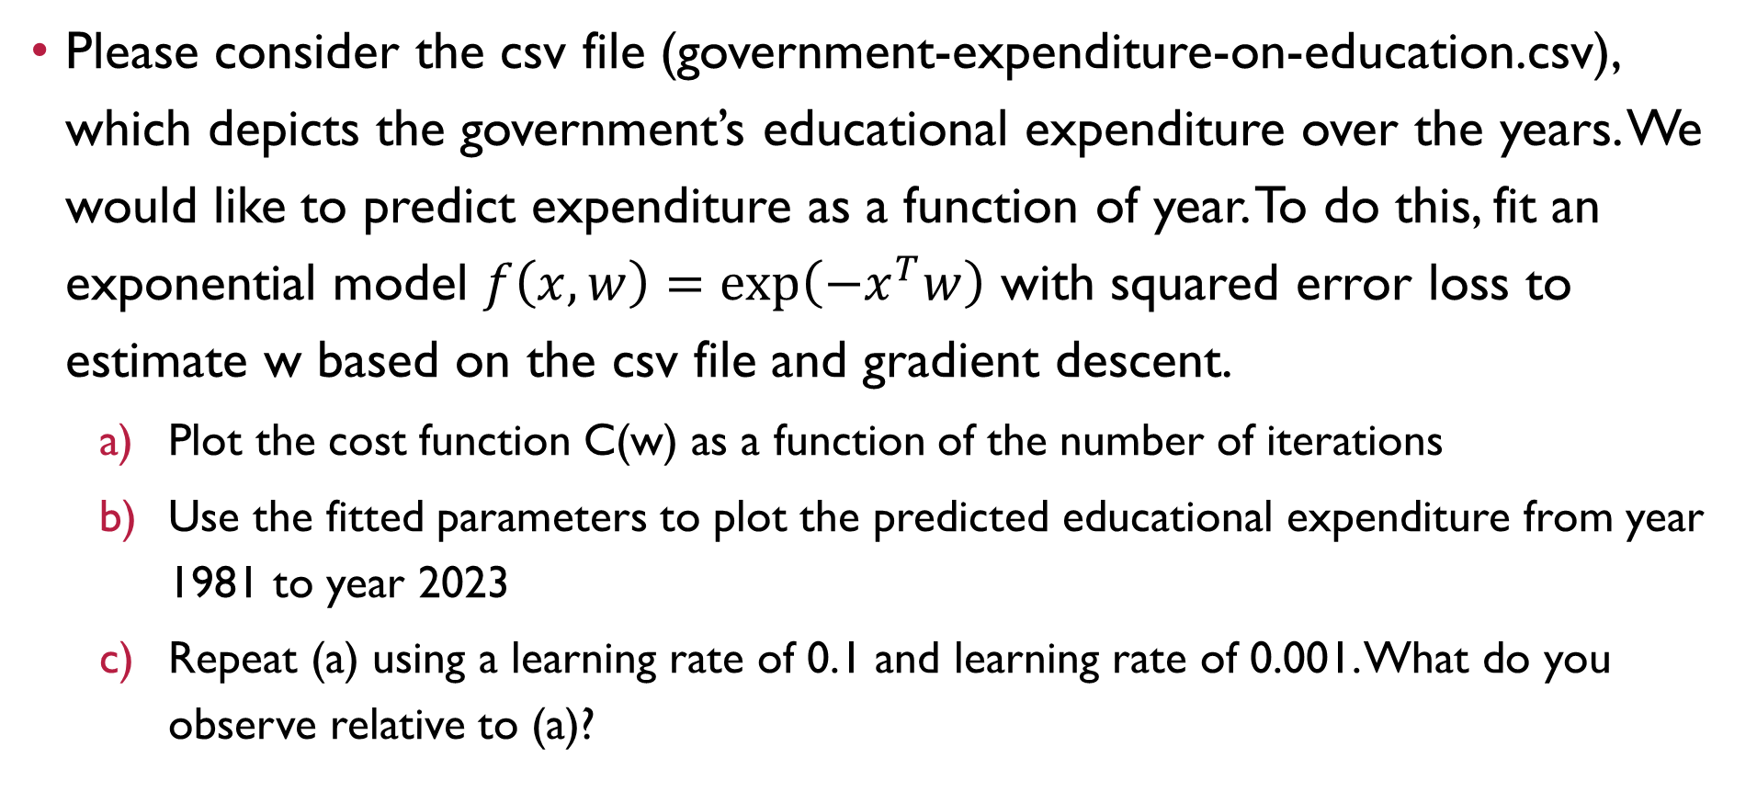
Question 2 (Python)
Please consider the csv file (government-expenditure-on-education.csv), which depicts the government’s educational expenditure over the years. We would like to predict expenditure as a function of year. To do this, fit an exponential model $f\left(x,w\right)=\exp\left(−x^{T}w\right)$ with squared error loss to estimate w based on the csv file and gradient descent.
Plot the cost function C(w) as a function of the number of iterations
Use the fitted parameters to plot the predicted educational expenditure from year 1981 to year 2023
Repeat (a) using a learning rate of 0.1 and learning rate of 0.001. What do you observe relative to (a)?

Slide 14
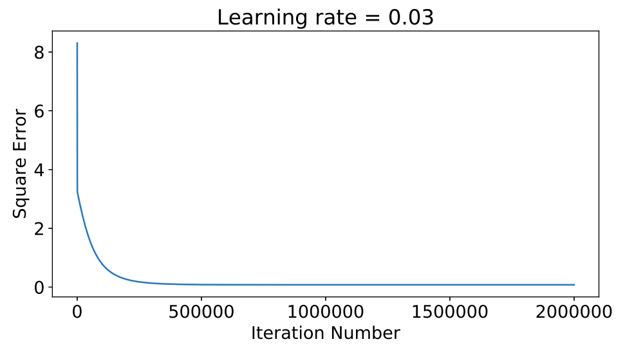
Question 2 (Python)
Plot the cost function C(w) as a function of the number of iterations
Decreases rapidly
Converges to a final value

Slide 15
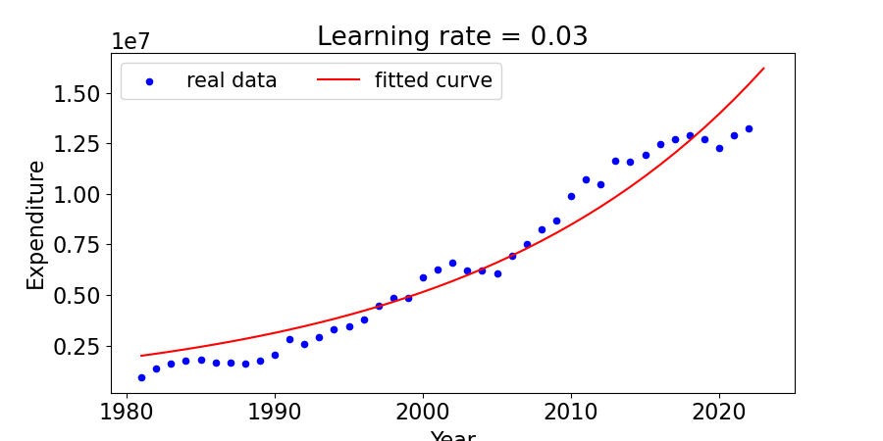
Question 2 (Python)
Use the fitted parameters to plot the predicted educational expenditure from year 1981 to year 2023

Slide 16
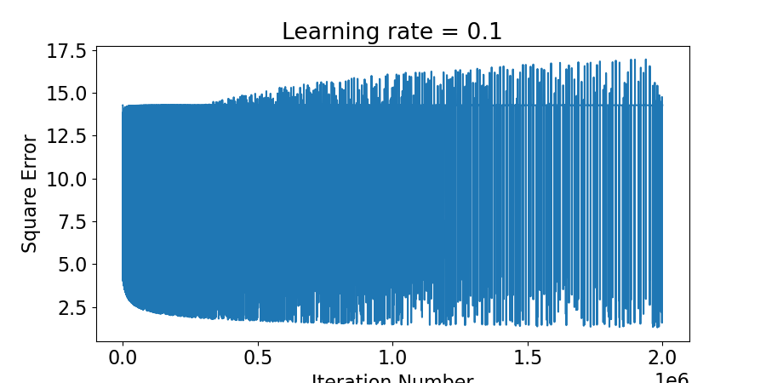
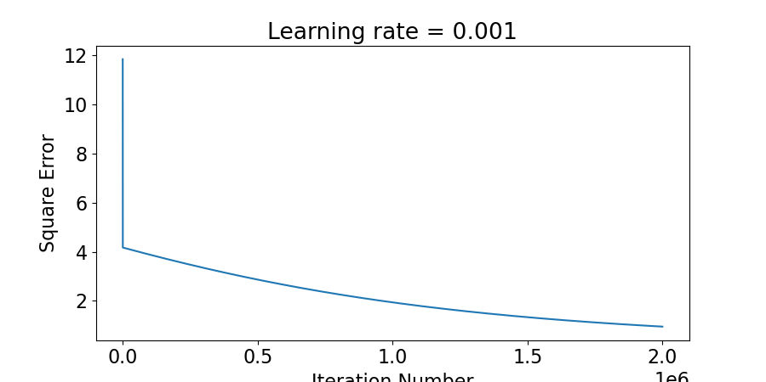
Question 2 (Python)
Repeat (a) using a learning rate of 0.1 and learning rate of 0.001. What do you observe relative to (a)?
A learning rate of 0.1 is too big, so the cost function does not decrease monotonically with increasing iterations, but instead fluctuate a lot without convergence. The final cost function value is much worse.
A learning rate of 0.001 is too small. So even though the cost function decreases monotonically with increasing iterations, gradient descent has not converged even after 2000000 iterations. The final cost function value is much worse.

Slide 17
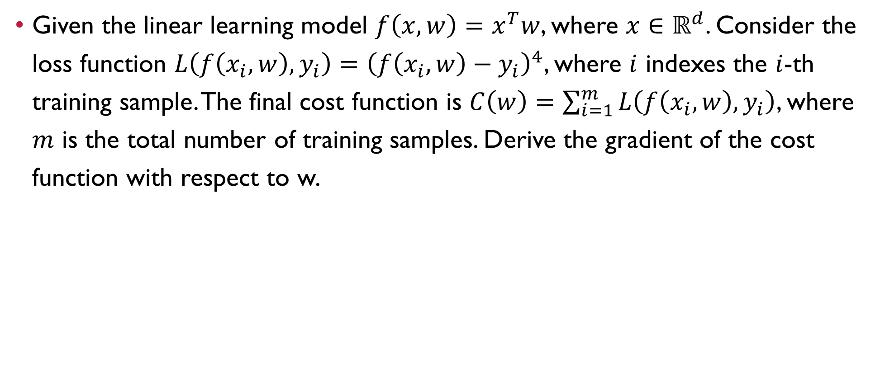
Question 3
Given the linear learning model $f\left(x,w\right)=x^{T}w$, where $x∈ℝ^{d}$. Consider the loss function $L\left(f\left(x_{i},w\right),y_{i}\right)={\left(f\left(x_{i},w\right)−y_{i}\right)}^{4}$, where $i$ indexes the $i$-th training sample. The final cost function is $C\left(w\right)=\sum_{i=1}^{m}{L\left(f\left(x_{i},w\right),y_{i}\right)}$, where $m$ is the total number of training samples. Derive the gradient of the cost function with respect to w.

Slide 18
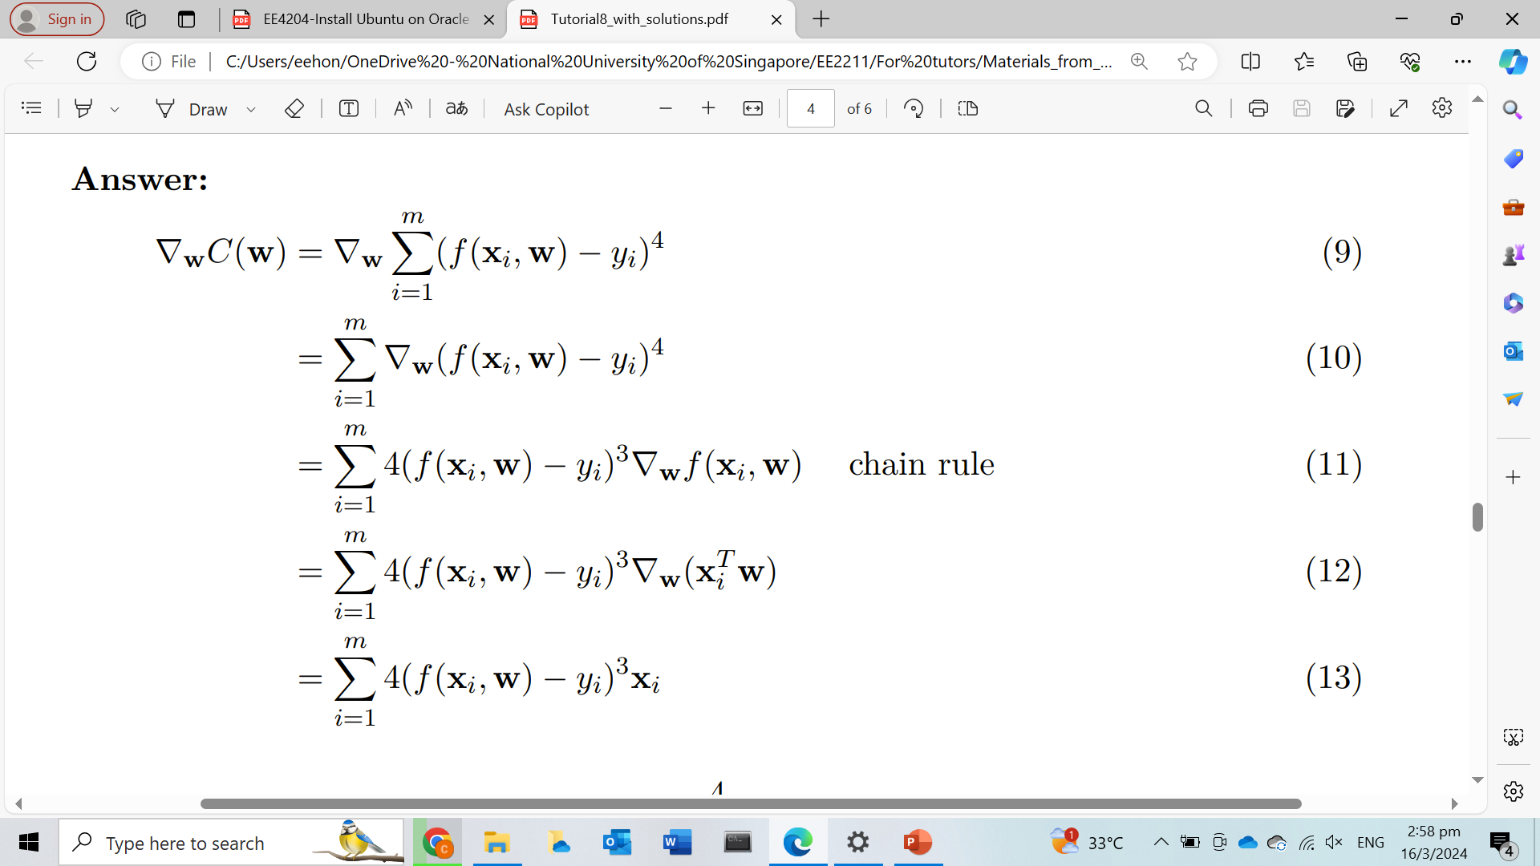
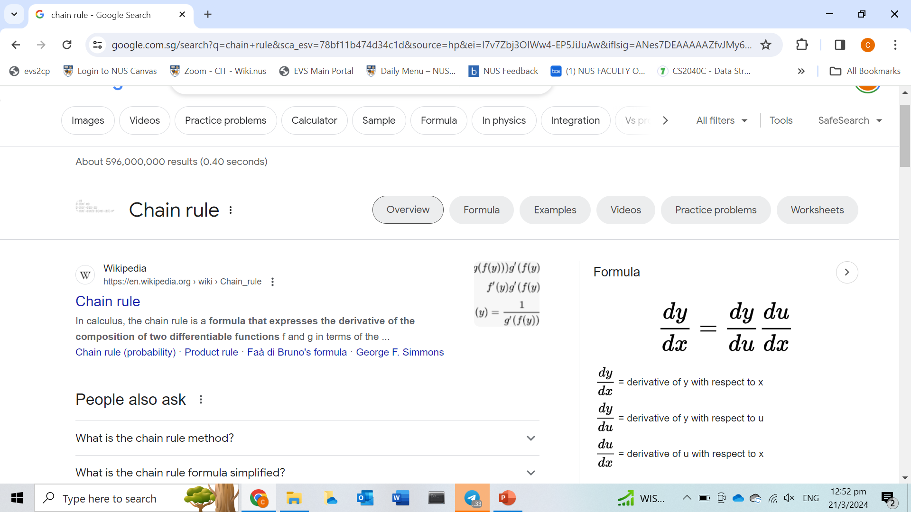
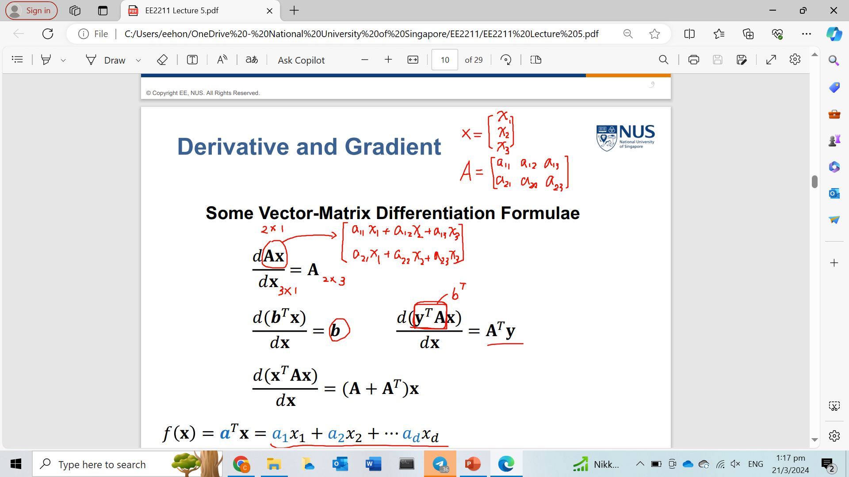
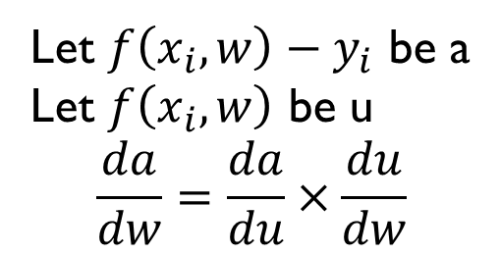
Question 3
Chain Rule:
Let $f\left(x_{i},w\right)−y_{i}$ be a
Let $f\left(x_{i},w\right)$ be u
$$\frac{da}{dw}=\frac{da}{du}×\frac{du}{dw}$$
Lecture 5 slide 8

Slide 19
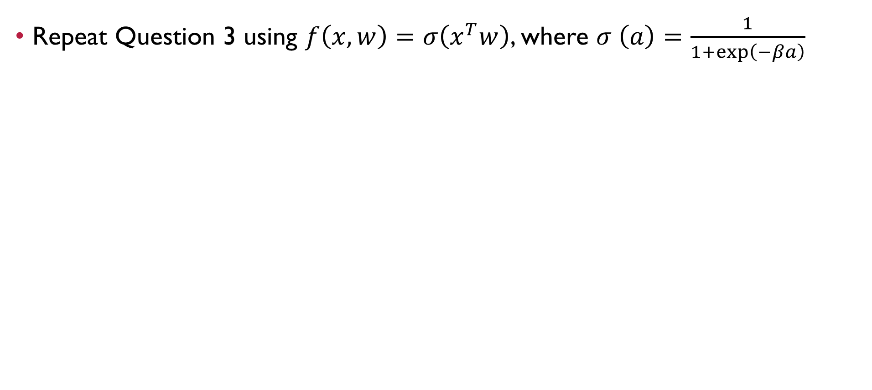
Question 4
Repeat Question 3 using $f\left(x,w\right)=σ\left(x^{T}w\right)$, where $σ \left(a\right)=\frac{1}{1+\exp\left(−βa\right)}$

Slide 20
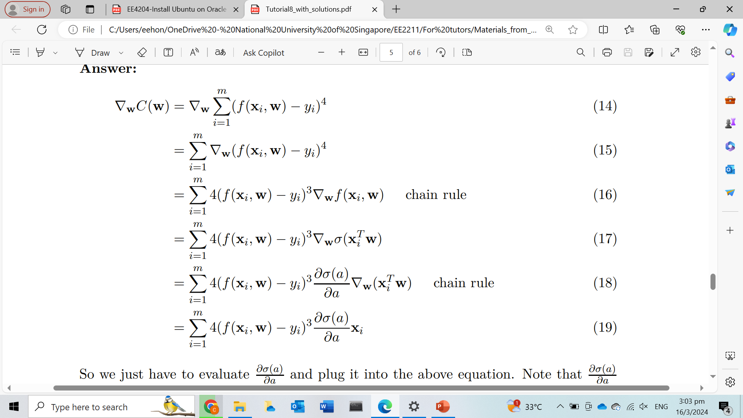
Question 4

Slide 21
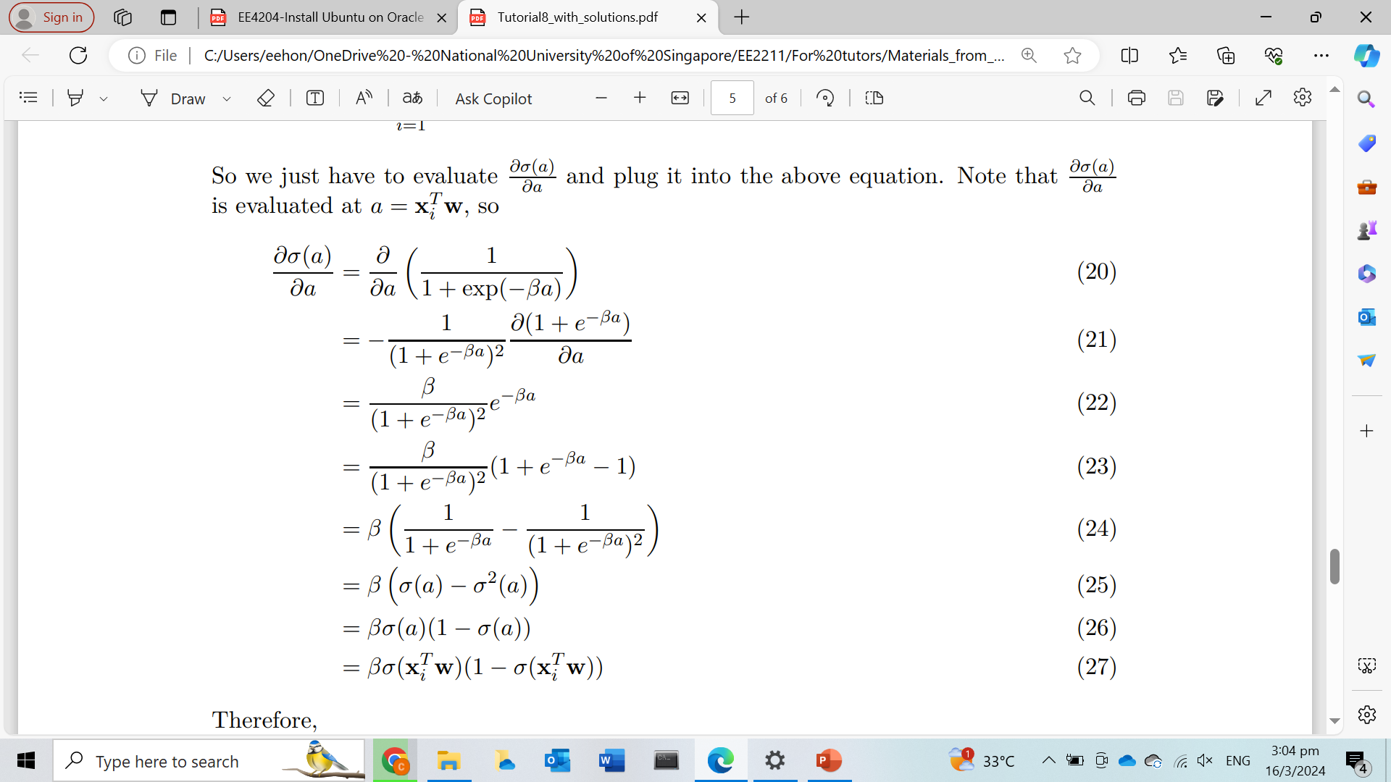
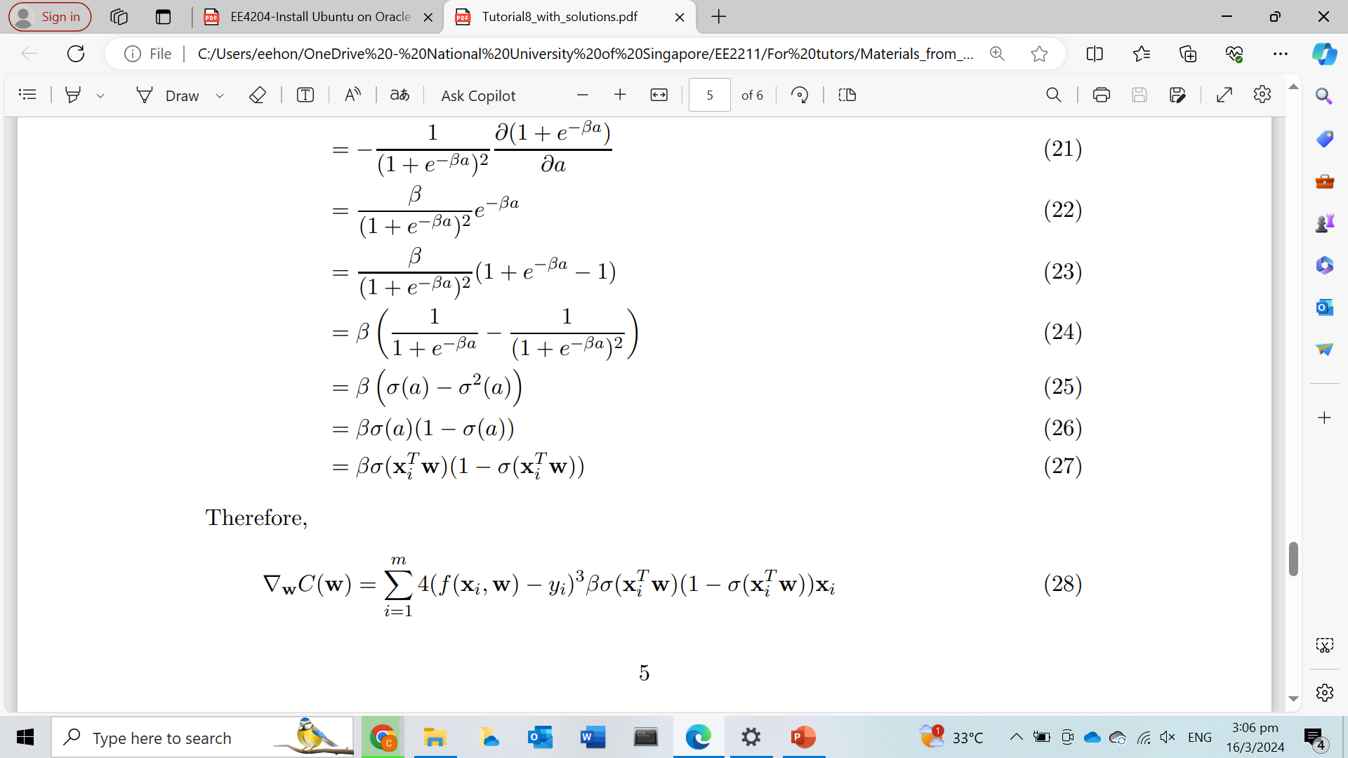
Question 4
From previous slide
Therefore,

Slide 22

Question 5
Repeat Question 3 using $f\left(x,w\right)=σ\left(x^{T}w\right)$, where $σ \left(a\right)=\max\left(0,a\right)$

Slide 23
Question 5
First part is the same as Q4

Slide 24
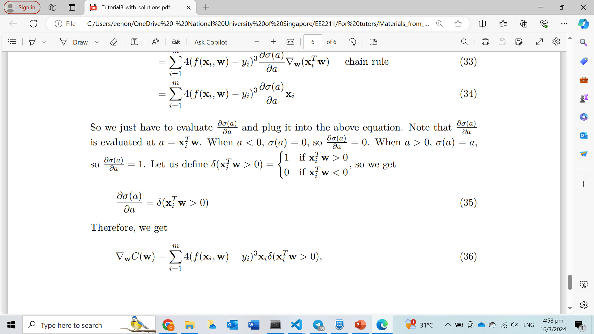

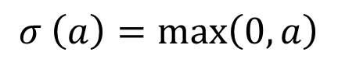
Question 5
$$σ \left(a\right)=\max\left(0,a\right)$$
From previous slide
Therefore,

Slide 25


Questions?
Feel free to come up to me if you have any questions about anything!
If you are shy, you can use the anonymous form to leave questions & feedback about the tutorial.
You can also reach out to me on our Telegram group or PM me at @eehongchan
Anonymous feedback
Telegram
https://forms.gle/c9QU94YcWjR3EZFk9

